Slide 1
Optimal Control and Scheduling of Computing Systems
EE4-T Final Year Project Presentation
28 June 2017
Anand Kasture
Supervisor: Dr Eric Kerrigan

Slide 2
Aims & Objectives
Optimal Control and Scheduling of Computing Systems
28 June 2017
Reinforce the natural applicability of robust mathematical optimisation methods to real-time multi-processor task-scheduling problems.
Establish desirable scaling properties of an optimisation based approach through efficient low-level algebraic computations.

Slide 3
Motivation
Optimal Control and Scheduling of Computing Systems
28 June 2017
Existing task-scheduling algorithms
Formulated as regulation problems
Designed in an ad-hoc manner
Based on open-loop metrics and worst-case estimates
Devoid of advancements in optimal control theory
Existing off-the-shelf optimisation software
Generality entails performing several auxiliary structure-detection routines

Slide 4
Project Outline
Optimal Control and Scheduling of Computing Systems
28 June 2017
Task Scheduling Problem
Feedback Scheduling Architecture
Workload Partitioning Problem
Linear Programming (LP) Formulation
Interior Point Methods (IPM)
Primal-Dual IPMs
Newton’s Method $$\text{Ax}\text{=}\text{b}$$
Newton’s Method "Ax=b"
Block Elimination & Matrix Factorisation
The Conjugate Gradient Method

Slide 5
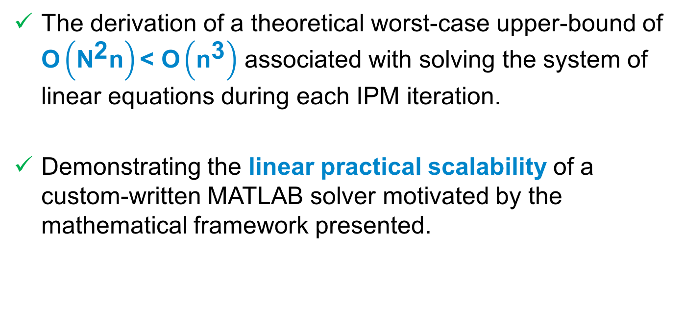
Main Contribution
Optimal Control and Scheduling of Computing Systems
28 June 2017
The derivation of a theoretical worst-case upper-bound of $\text{O}\left({\text{N}}^{\text{2}}\text{n}\right)\text{< }\text{O}\left({\text{n}}^{\text{3}}\right)$ associated with solving the system of linear equations during each IPM iteration.
Demonstrating the linear practical scalability of a custom-written MATLAB solver motivated by the mathematical framework presented.

Slide 6
Approach
Optimal Control and Scheduling of Computing Systems
28 June 2017
Performing a specific sequence of block eliminations to reduce problem dimensionality
Exploiting the inherent low-level sparsity structures in order to factorise the left-hand side matrix
Solving the reduced system of linear equations with the conjugate-gradient method

Slide 7
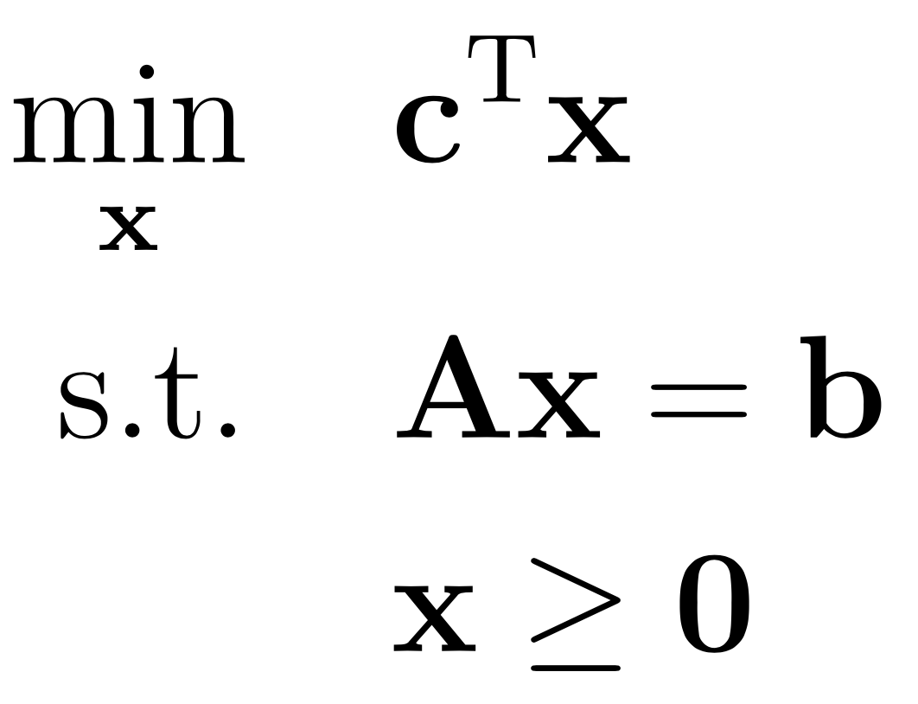
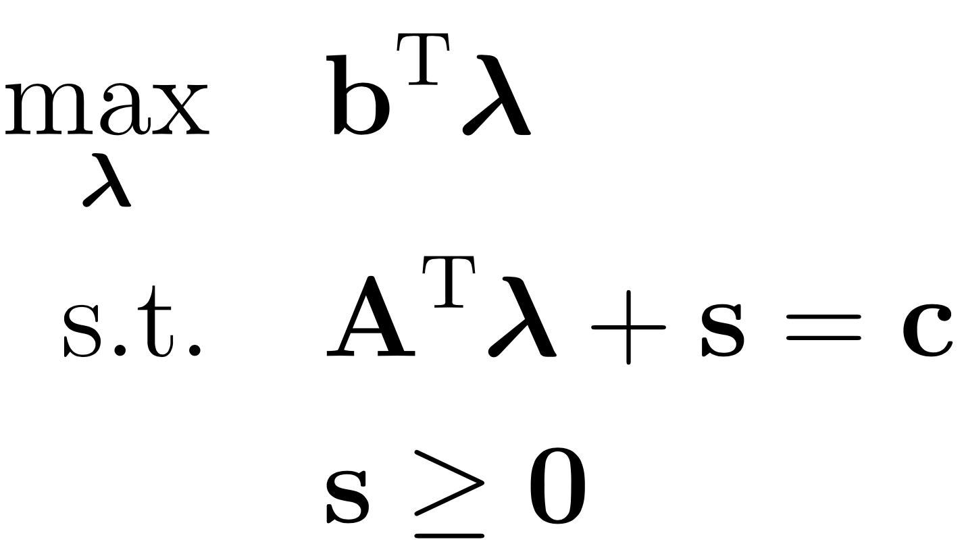
Linear Programming
Optimal Control and Scheduling of Computing Systems
28 June 2017
PRIMAL
DUAL

Slide 8
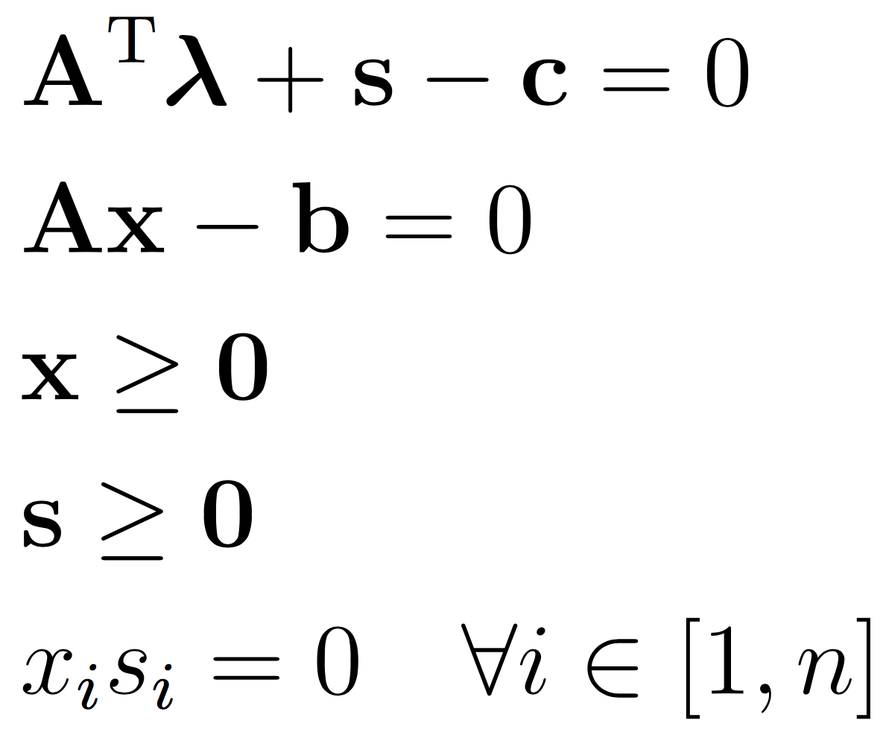
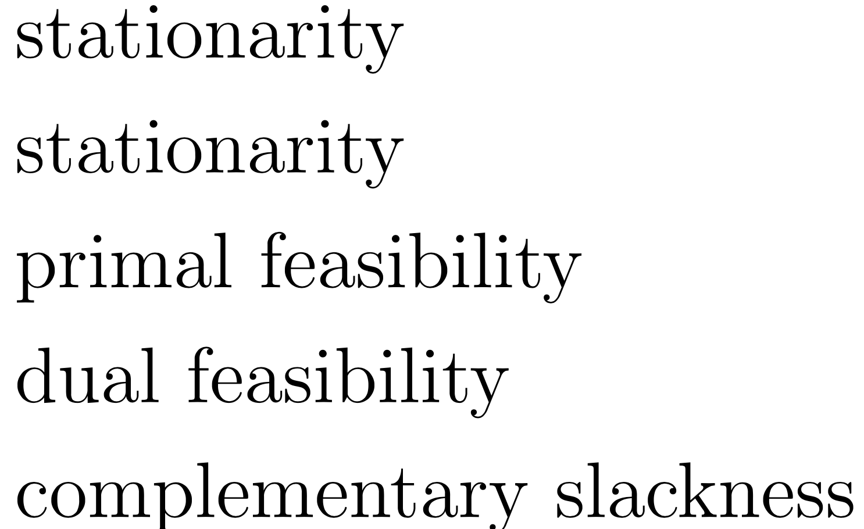
Karush-Kuhn-Tucker (KKT) Conditions
Optimal Control and Scheduling of Computing Systems
28 June 2017
Obtain search direction using Newton’s Method Calculate step length such that primal/dual feasibility is maintained

Slide 9
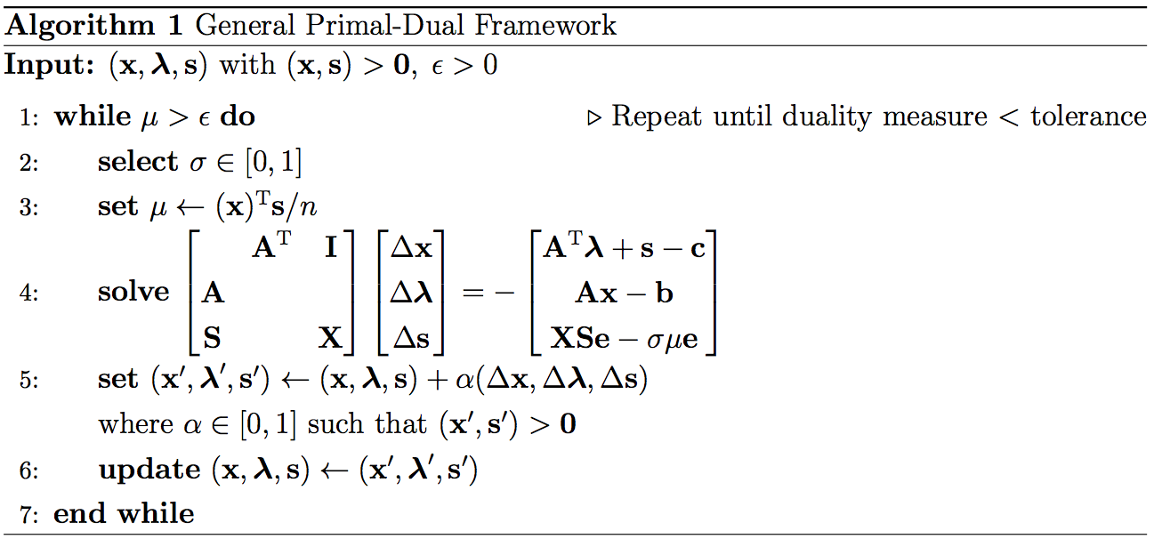
Primal-Dual Interior Point Methods
Optimal Control and Scheduling of Computing Systems
28 June 2017
Largest computational bottleneck

Slide 10
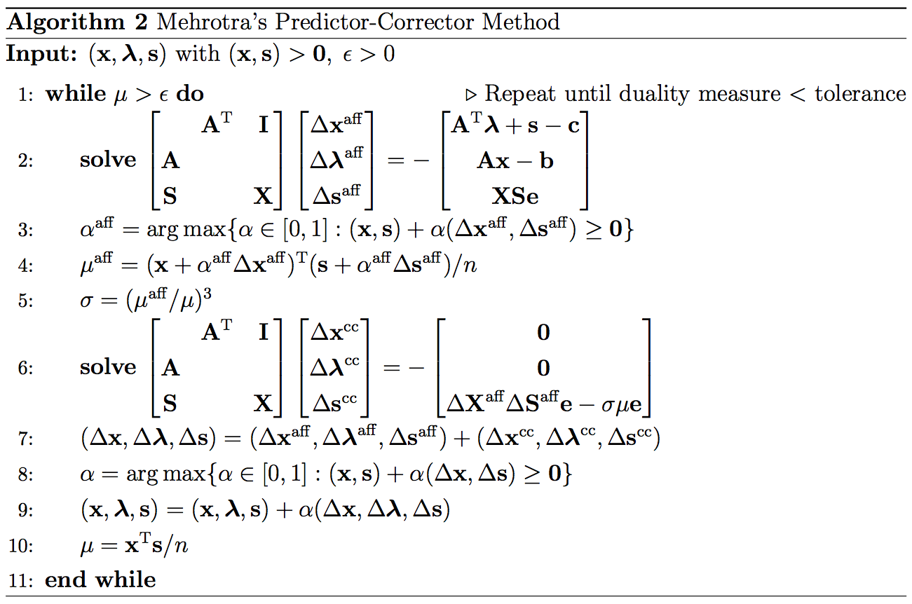
Mehrotra’s Predictor-Corrector Method
Optimal Control and Scheduling of Computing Systems
28 June 2017
2 solves per iteration

Slide 11
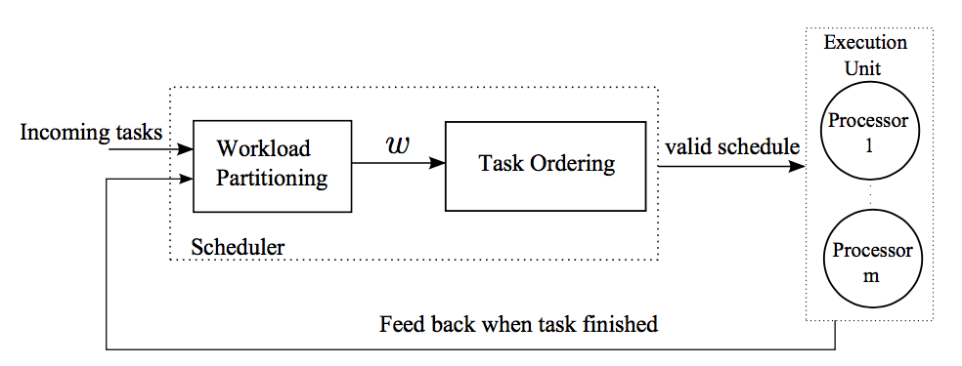
Feedback Scheduling Architecture
Optimal Control and Scheduling of Computing Systems
28 June 2017
Discrete-Time Optimal Control Problem
[Thammawichai and Kerrigan, 2016] Thammawichai, M. and Kerrigan, E. C. (2016). Feedback scheduling for energy-efficient real-time homogeneous multiprocessor systems. In 2016 IEEE 55th Conference on Decision and Control (CDC)

Slide 12
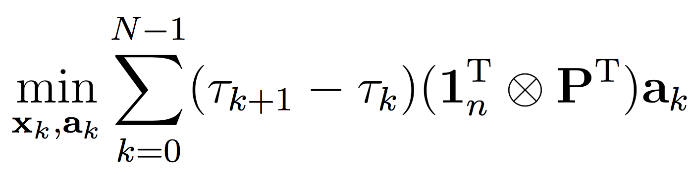
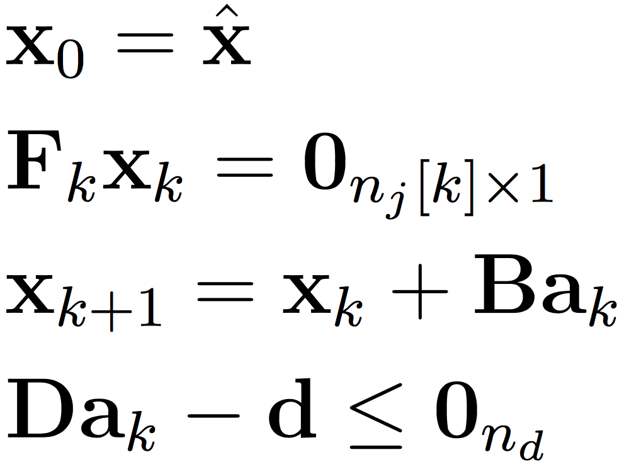
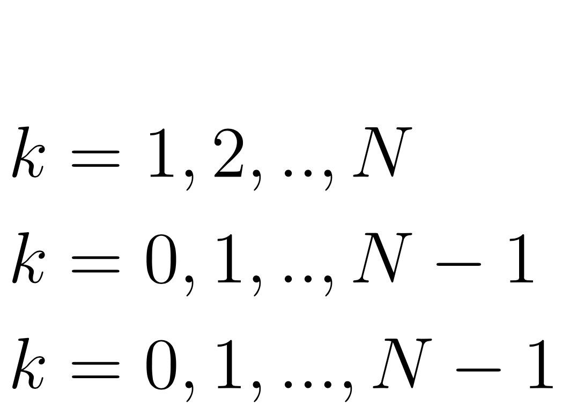
Different Deadline LP Formulation
Optimal Control and Scheduling of Computing Systems
28 June 2017

Slide 13
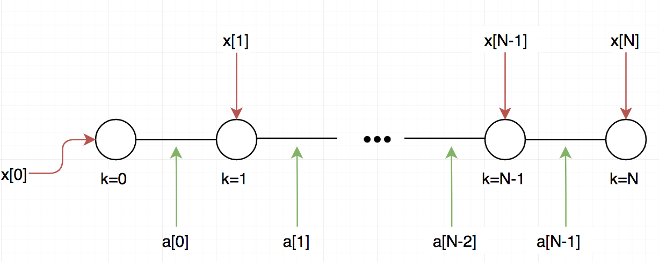
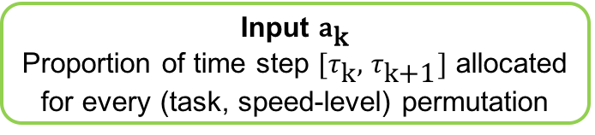
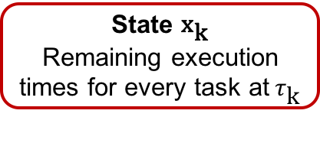
Decision Variables
Optimal Control and Scheduling of Computing Systems
28 June 2017
State ${\text{x}}_{\text{k}}$ Remaining execution times for every task at${ τ}_{\text{k}}$
Input ${\text{a}}_{\text{k}}$ Proportion of time step ${[τ}_{\text{k}},$ $τ_{\text{k}\text{+1}}]$ allocated for every (task, speed-level) permutation

Slide 14
Example Solution
Optimal Control and Scheduling of Computing Systems
28 June 2017
Parameter | Size
Number of Tasks (n) | 200
Number of Time Steps (N) | 2
Number of Speed Levels (l) | 10

Slide 15
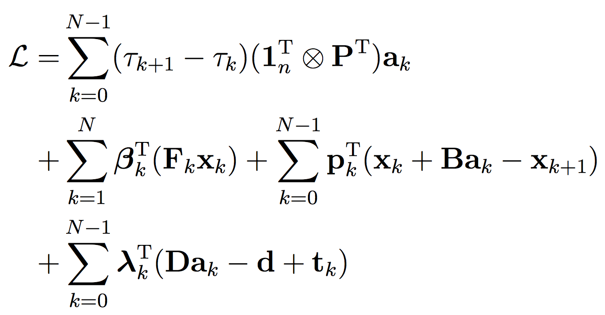
The Lagrangian
Optimal Control and Scheduling of Computing Systems
28 June 2017

Slide 16
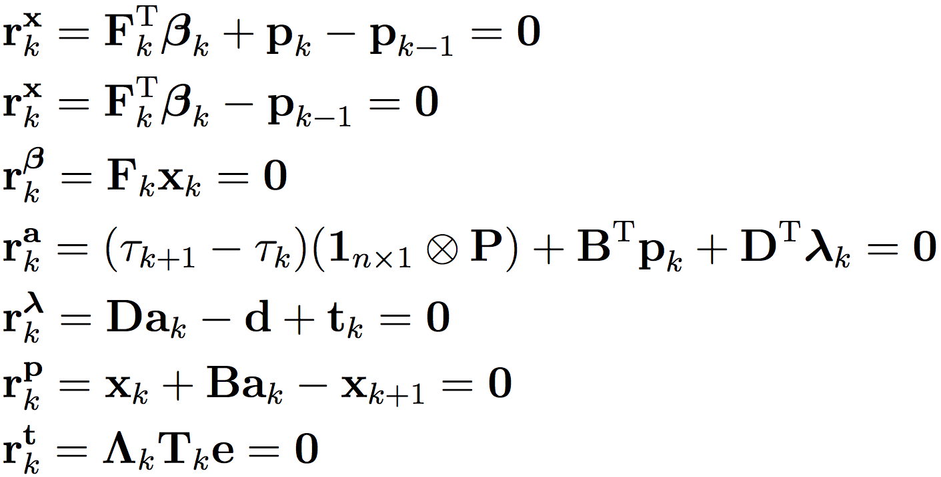
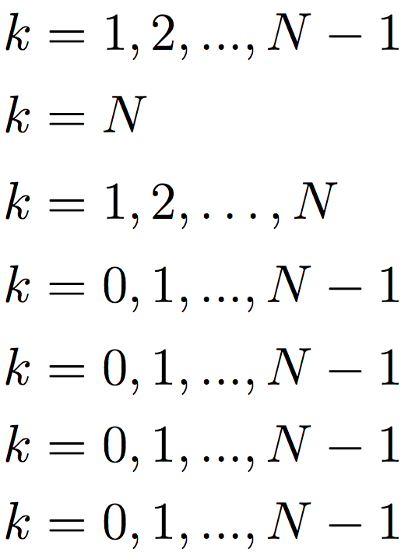
The KKT Optimality Conditions
Optimal Control and Scheduling of Computing Systems
28 June 2017

Slide 17
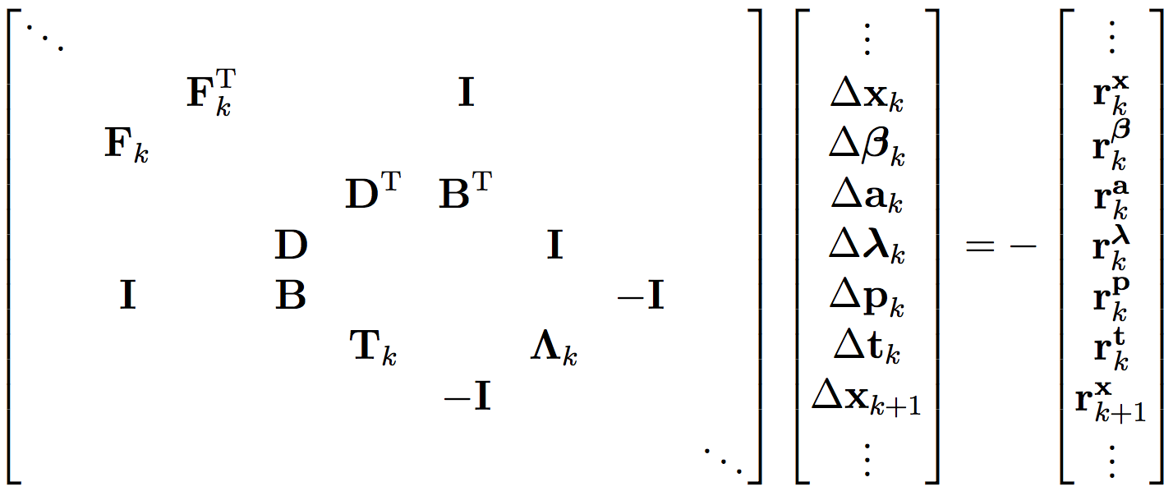
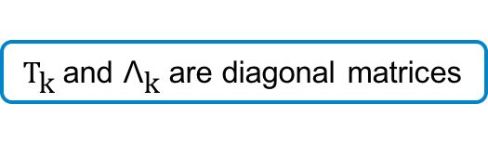
Newton’s Method
Optimal Control and Scheduling of Computing Systems
28 June 2017
${\text{T}}_{\text{k}}$and ${\text{Λ}}_{\text{k}}$are diagonal matrices

Slide 18
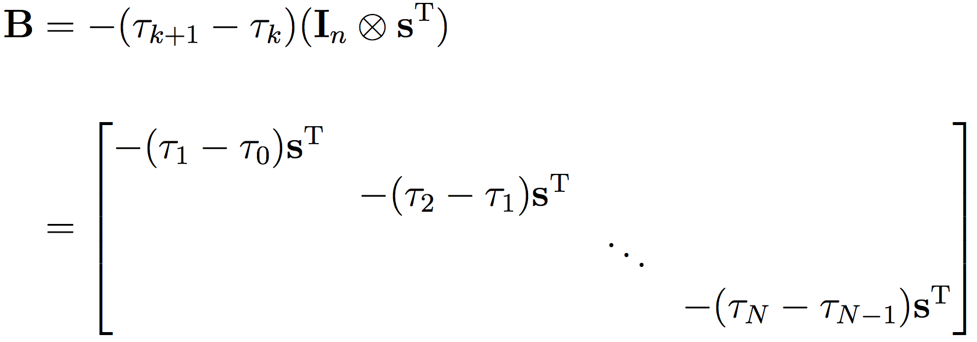
Constituent Sub-Block Matrices (B)
Optimal Control and Scheduling of Computing Systems
28 June 2017

Slide 19
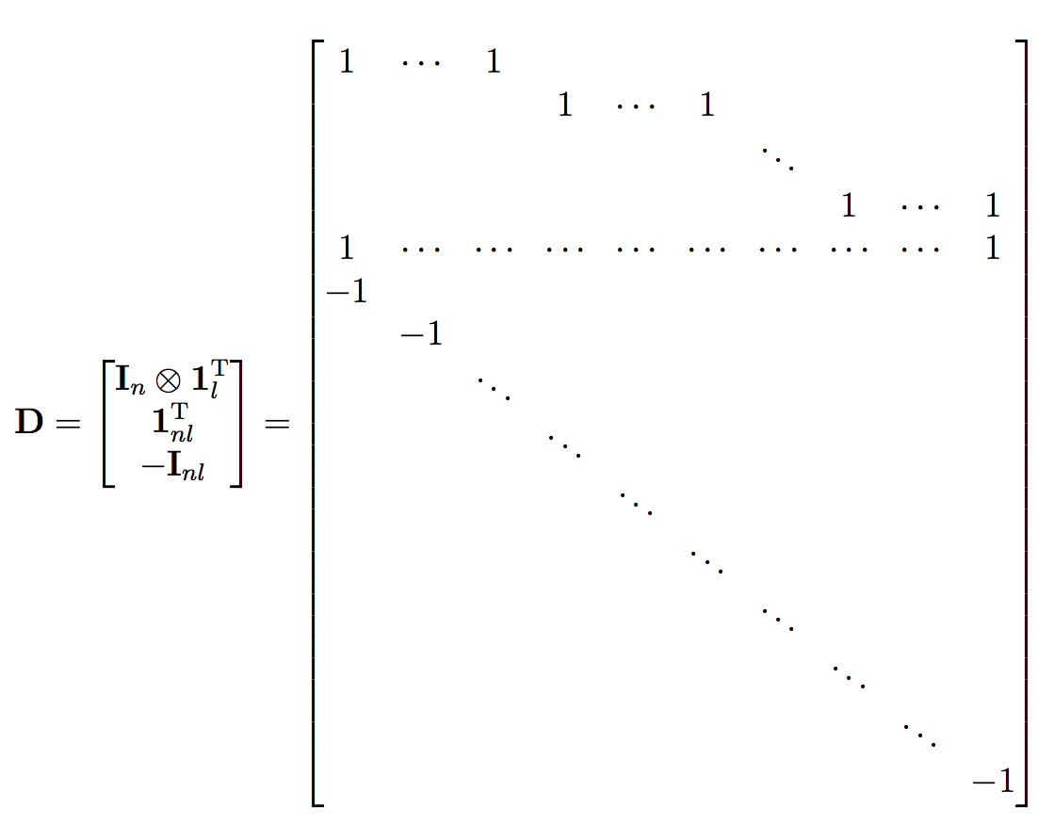
Constituent Sub-Block Matrices (D)
Optimal Control and Scheduling of Computing Systems
28 June 2017

Slide 20
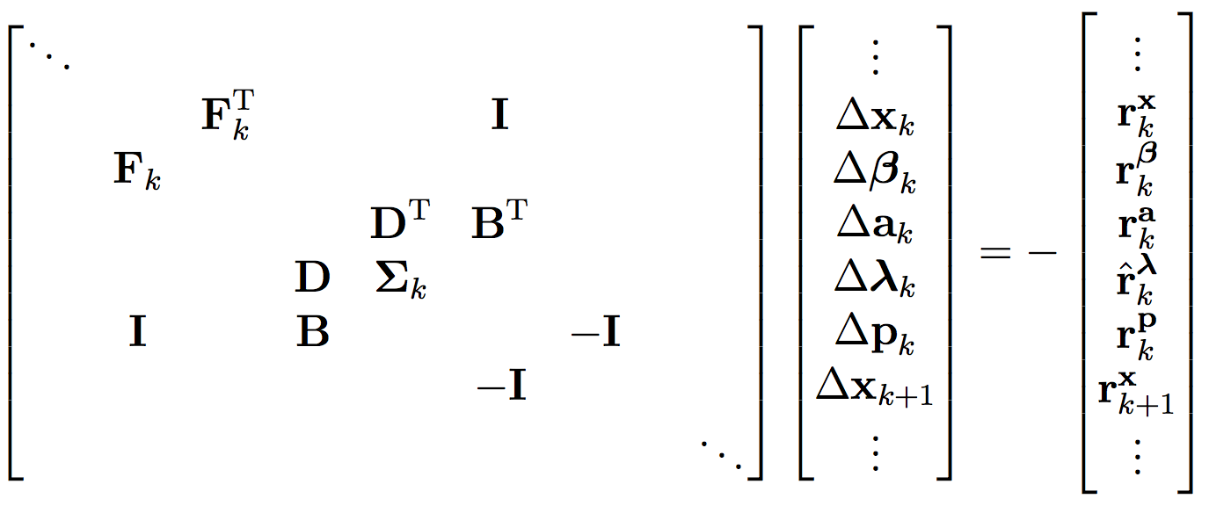
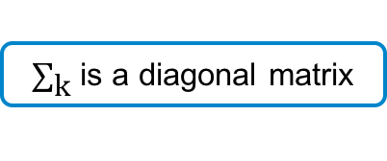
Eliminating $\text{∆}{\text{t}}_{\text{k}}$
Optimal Control and Scheduling of Computing Systems
28 June 2017
${\text{∑}}_{\text{k}}$is a diagonal matrix

Slide 21
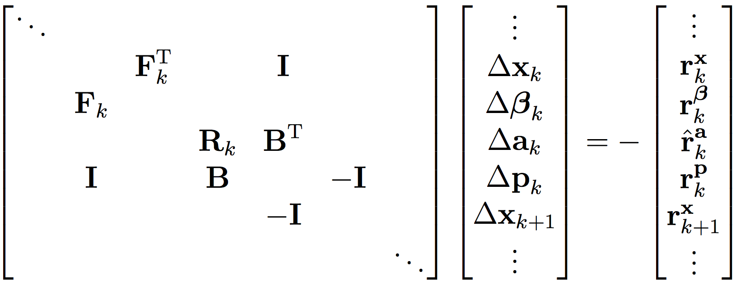
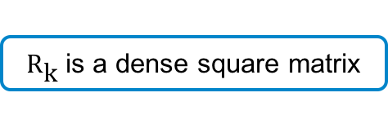
Eliminating $\text{∆}{\text{λ}}_{\text{k}}$
Optimal Control and Scheduling of Computing Systems
28 June 2017
${\text{R}}_{\text{k}}$is a dense square matrix

Slide 22
The Reduced Jacobian Matrix
Optimal Control and Scheduling of Computing Systems
28 June 2017
Jacobian for (n,N,l) = (4,2,5)
Jacobian for (n,N,l) = (20,10,25)

Slide 23
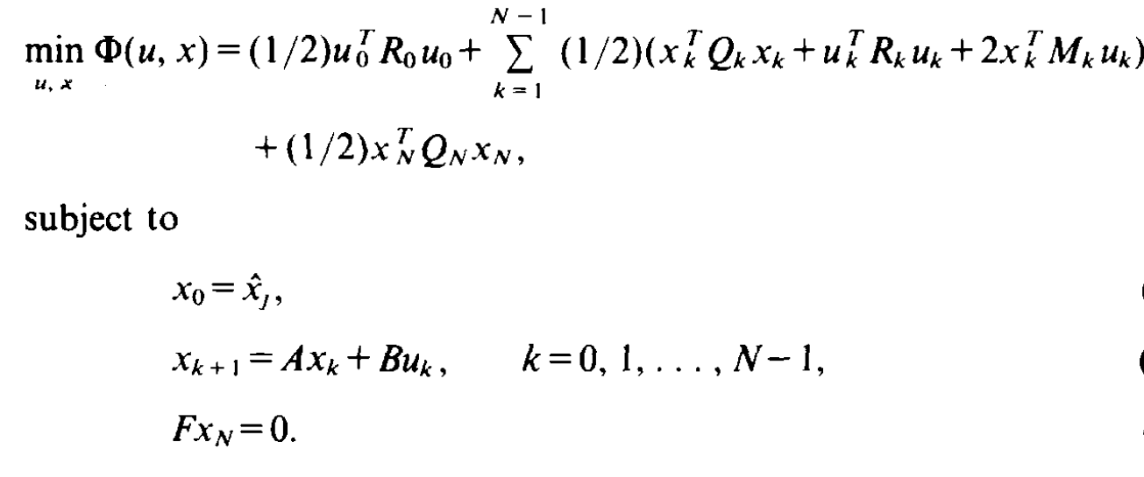
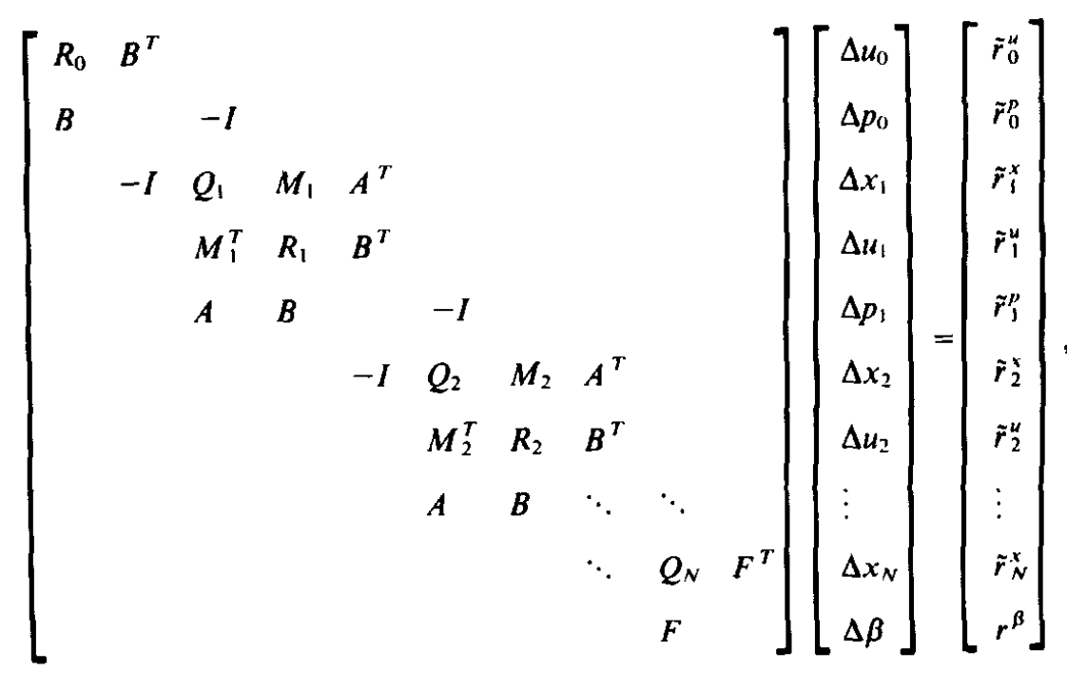
The Rao, Wright & Rawlings Paper
Optimal Control and Scheduling of Computing Systems
28 June 2017
Rao, C. V., Wright, S. J. & Rawlings, J. B. (1998), ‘Application of interior-point methods to model predictive control’, Journal of optimization theory and applications 99(3), 723– 757.

Slide 24
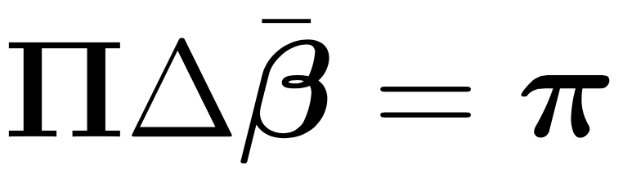
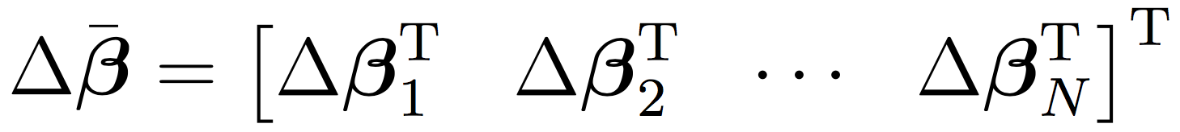
Eliminating $\text{∆}{\text{x}}_{\text{k}}\text{, }\text{∆}{\text{a}}_{\text{k}}\text{, }\text{∆}{\text{p}}_{\text{k}}$
Optimal Control and Scheduling of Computing Systems
28 June 2017

Slide 25
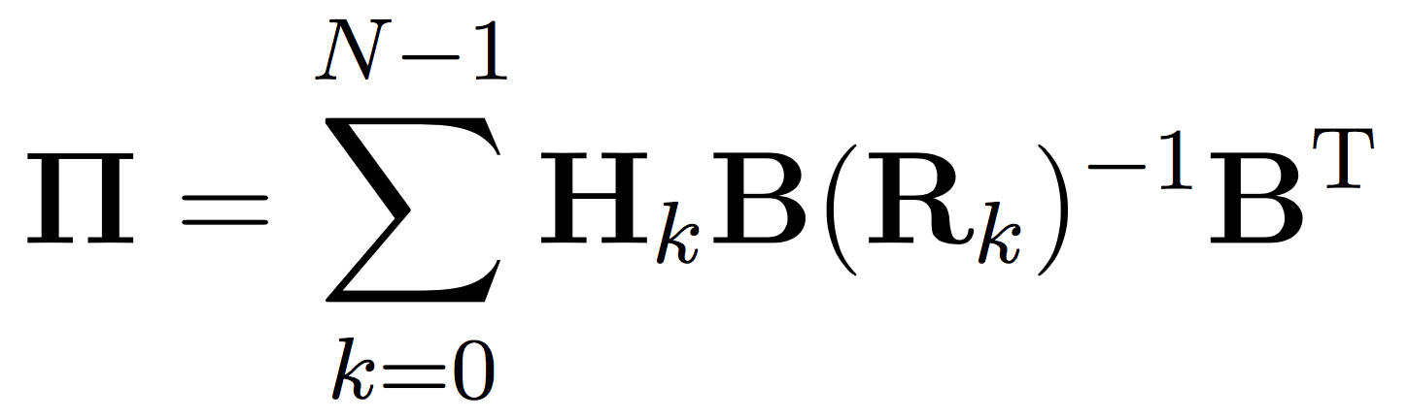
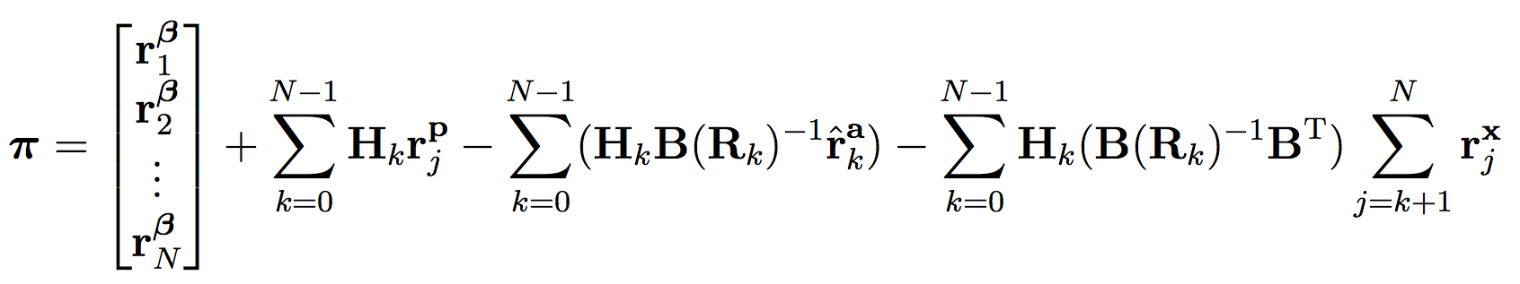
Eliminating $\text{∆}{\text{x}}_{\text{k}}\text{, }\text{∆}{\text{a}}_{\text{k}}\text{, }\text{∆}{\text{p}}_{\text{k}}$
Optimal Control and Scheduling of Computing Systems
28 June 2017

Slide 26
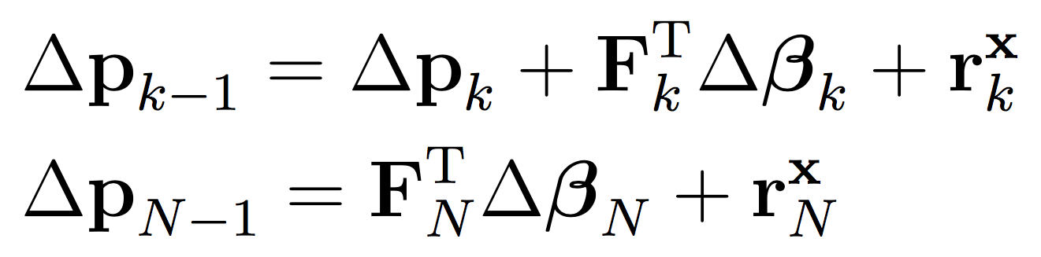
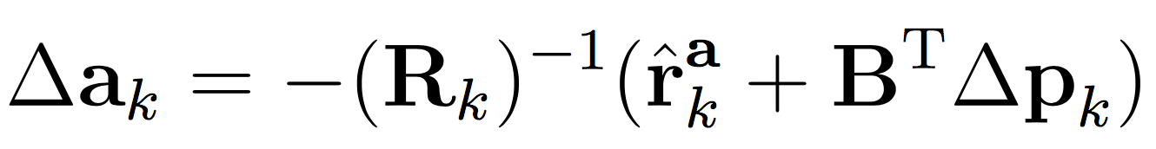
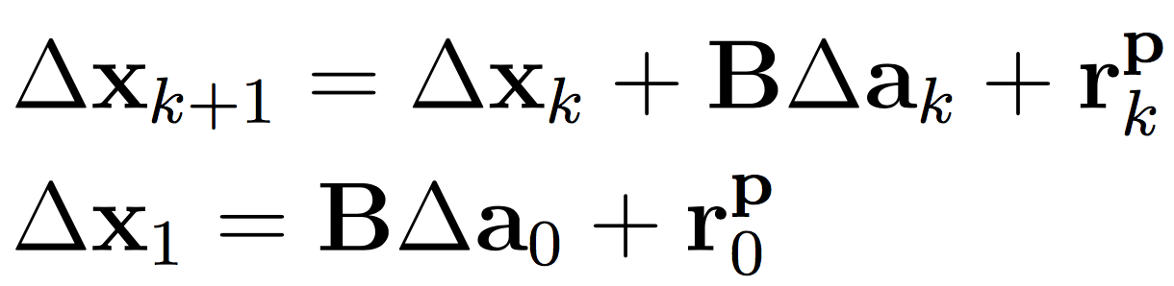
Reconstruction Equations
Optimal Control and Scheduling of Computing Systems
28 June 2017

Slide 27
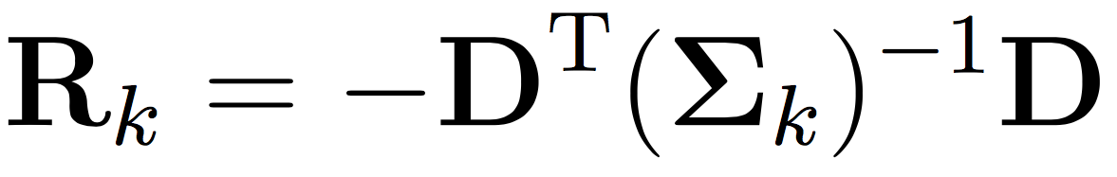
Computing $R_{k}^{−1}$
Optimal Control and Scheduling of Computing Systems
28 June 2017
DENSE !

Slide 28
Computing $R_{k}^{−1}$
Optimal Control and Scheduling of Computing Systems
28 June 2017
Sparse Constituents

Slide 29
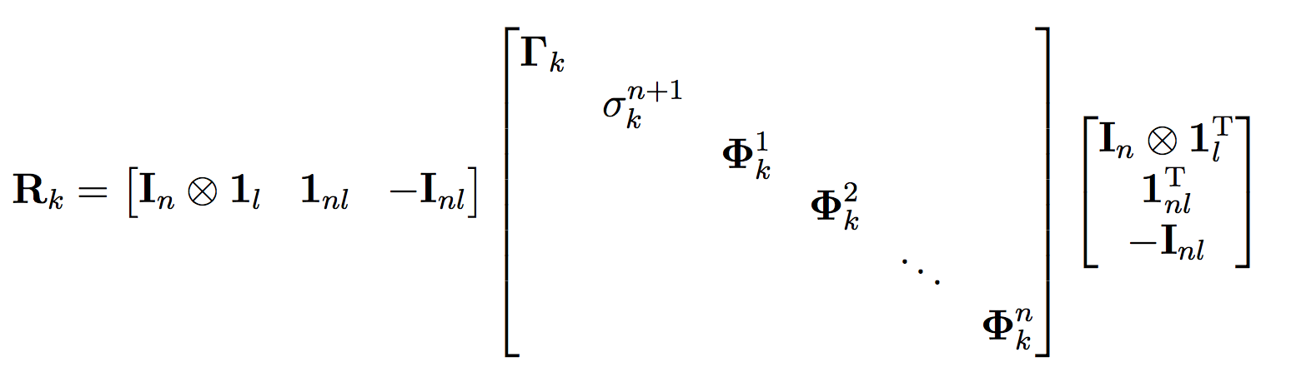
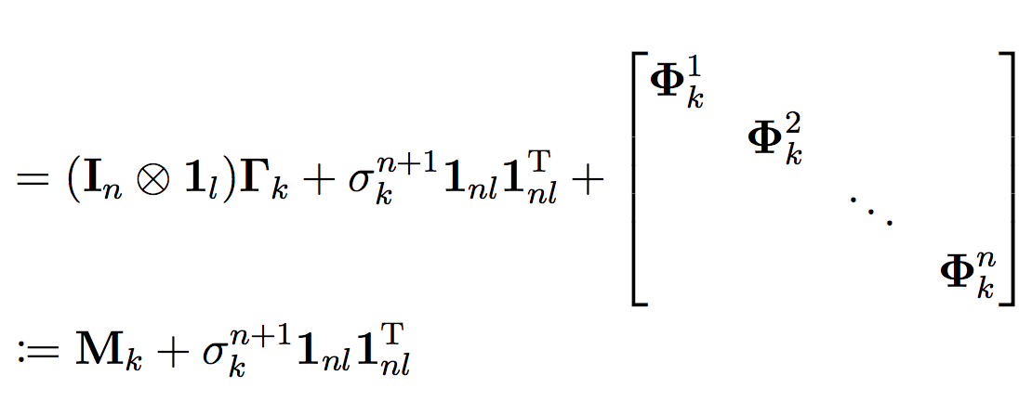
Rewriting$R$
Optimal Control and Scheduling of Computing Systems
28 June 2017
Matrix R: Block Diagonal + Rank-1 Matrix

Slide 30
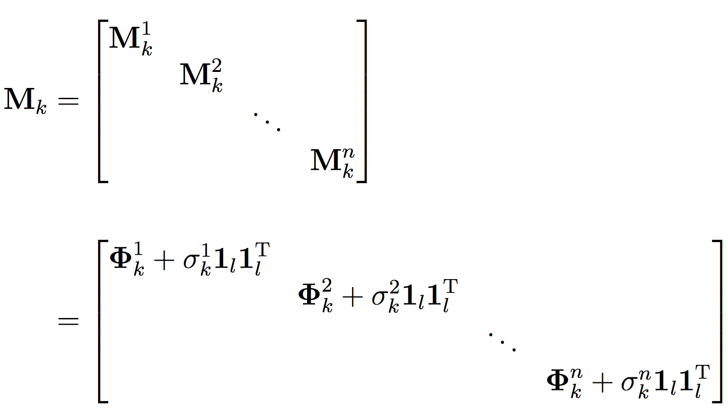
Rewriting$M$
Optimal Control and Scheduling of Computing Systems
28 June 2017
Each Sub-Block: Diagonal + Rank-1 Matrix
Can easily calculate this inverse using Sherman-Morrison !

Slide 31
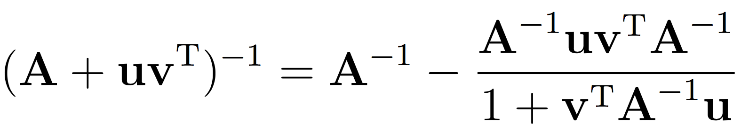
The Sherman-Morrison Formula
Optimal Control and Scheduling of Computing Systems
28 June 2017

Slide 32
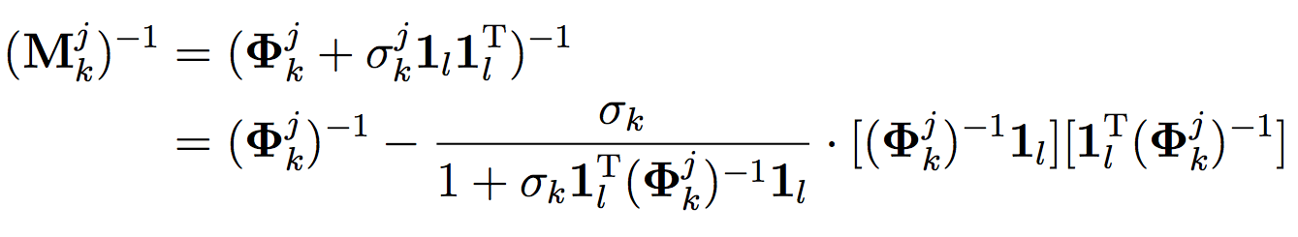
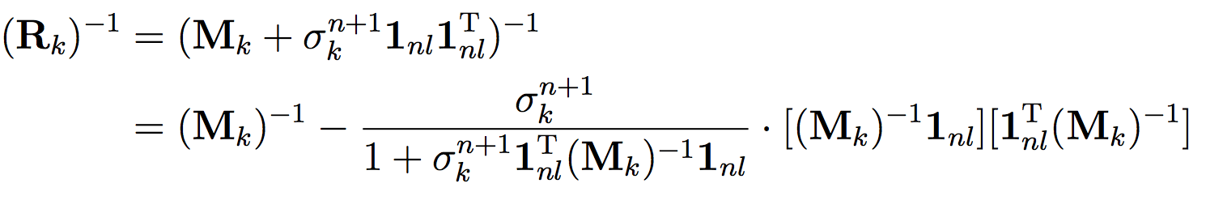
The Sherman-Morrison Formula
Optimal Control and Scheduling of Computing Systems
28 June 2017

Slide 33
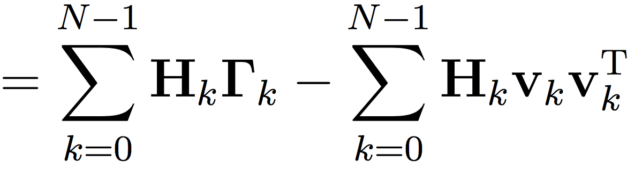
Rewriting 𝚷
Optimal Control and Scheduling of Computing Systems
28 June 2017
Substituting the derived expression for R
The Left-Hand Side can be written as a sum of N diagonal matrices and N outer-products

Slide 34
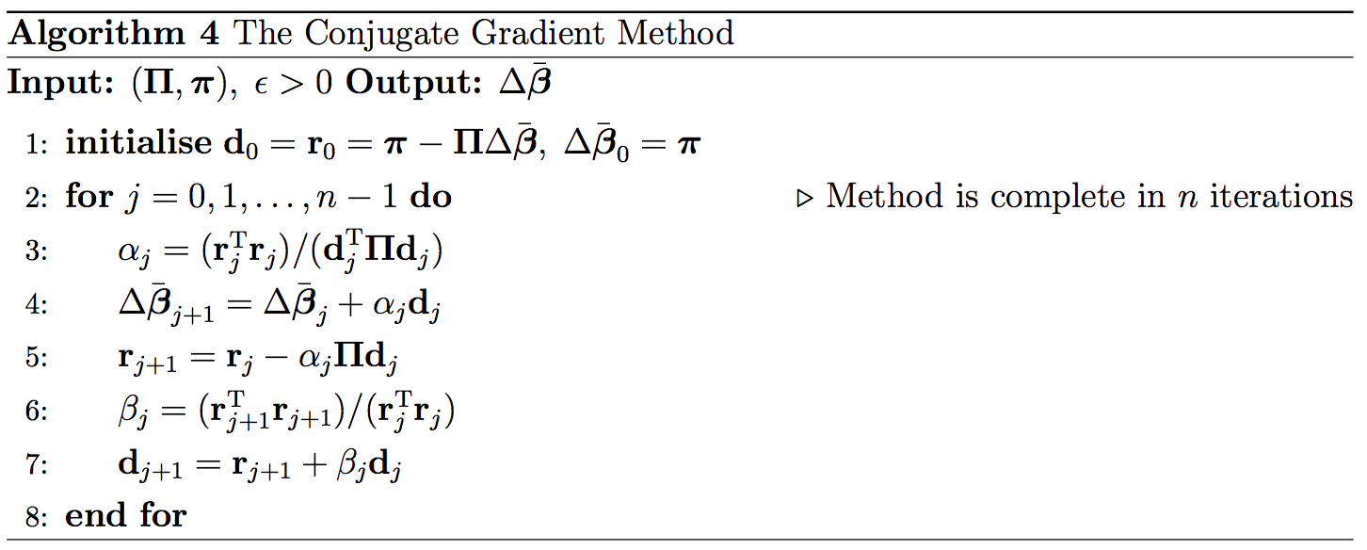
The Conjugate Gradient Method
Optimal Control and Scheduling of Computing Systems
28 June 2017

Slide 35
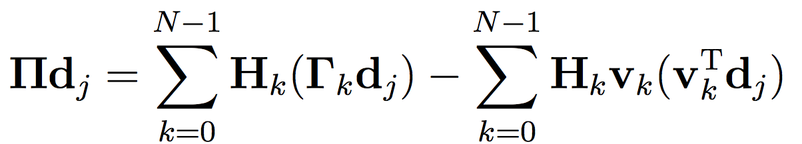
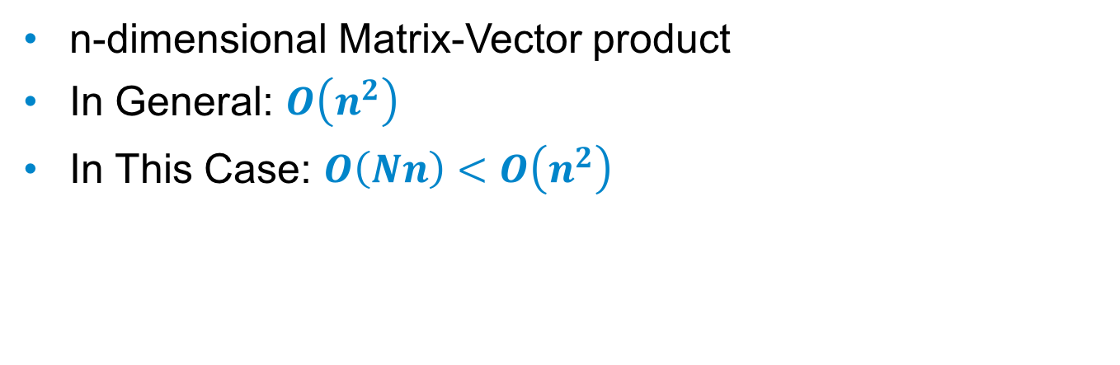
Complexity Analysis
Optimal Control and Scheduling of Computing Systems
28 June 2017
n-dimensional Matrix-Vector product
In General: $O\left(n^{2}\right)$
In This Case: $O\left(Nn\right)<O\left(n^{2}\right)$

Slide 36

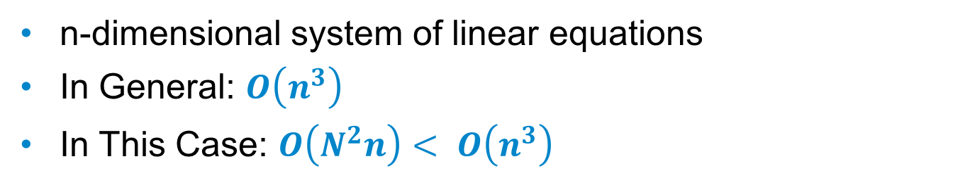
How many Conjugate Gradient Iterations?
Optimal Control and Scheduling of Computing Systems
28 June 2017
n-dimensional system of linear equations
In General: $O\left(n^{3}\right)$
In This Case: $O\left(N^{2}n\right)< O\left(n^{3}\right)$
Usually, CG requires at most n iterations for an n-dimensional system.
However, we only require at most N+1iterations since the LHS can be expressed as a symmetric positive-definite + rank deficient matrix (rank = N < n).
Golub, G. H. & Van Loan, C. F. (2012), Matrix computations, Vol. 3, JHU Press.

Slide 37
MATLAB Implementation Details
Optimal Control and Scheduling of Computing Systems
28 June 2017
Practical scaling results obtained for several iterations of a custom-written IPM in MATLAB
Best performing version: DDP-AK7213-V5-CGS
Low-level implementation of the mathematics
Function devoid of ANY matrix multiplications
Linear scaling in ALL problem size parameters

Slide 38
MATLAB Implementation Scaling Results
Optimal Control and Scheduling of Computing Systems
28 June 2017
Gradient = 1.0205

Slide 39
MATLAB Implementation Scaling Results
Optimal Control and Scheduling of Computing Systems
28 June 2017
Gradient = 1.0401

Slide 40
MATLAB Implementation Scaling Results
Optimal Control and Scheduling of Computing Systems
28 June 2017
Gradient = 0.9932

Slide 41
Conclusion
Optimal Control and Scheduling of Computing Systems
28 June 2017
Reinforce the natural applicability of robust mathematical optimisation methods to real-time multi-processor task-scheduling problems.
Establish desirable scaling properties of an optimisation based approach through efficient low-level algebraic computations.

